Slide 1
Phase II: Supply Chain Design
EA Input to 1st Steering Committee meeting
1st Steering Committee
Aug 27, 2003

Slide 2
Processes impacts on
Vendor / POS / RMS / ERP Flows
Vendor
Store
Katz
RMS
POS
ERP
3. Merchandise
Planning
4. Planning & Distribution
6. Manage Suppliers
8. Manage Store Operations
10. Finance
1. Planning & Analysis

Slide 3
Vendor – Store – Katz (RMS) Scenarios
BR1 – Business Release 1
PO - Purchase Order
electronic, email, Phone Call, Fax, or Representative
McKesson – Telxon / Pharmaclick, proprietary electronic
interface (Portal, Phone, or through POS in some stores)
Vendor
Store
Invoices &
Claims
Electronic (EDI/XML or proprietary) or Paper
Invoices & Claims need to be by Item
Vendors:
Distributors
  McKesson
  Lumsden
  K&F
DSD (Direct Store Delivery)
Sales
POS – Daily downloads
  Sales
Dispensary – Daily downloads
Katz
RMS
Centrally controlled Item Master
Inventory – based on Invoices & Claims

Slide 4
Vendor – Store – Katz (RMS) Scenarios
BR2 – Business Release 2
Minimize
PO - Purchase Order
electronic, email, Phone Call, Fax, or Representative
McKesson – Telxon / Pharmaclick, proprietary electronic
interface (Portal, Phone, or through POS in some stores)
Vendor
Store
PO – Purchase Order
Replenishment
Invoices &
Claims
Based on RMS
Inventory
SOQ – Suggested
Order Quantity
Send PO copy
Based on RMS Inventory
Based on SOQ response
from Stores
Electronic (EDI/XML or proprietary) or Paper
Invoices & Claims need to be by Item
Vendors:
Distributors
  McKesson
  Lumsden
  K&F
DSD (Direct Store Delivery)
Sales
SOQ
POS – Daily downloads
  Sales
Dispensary – Daily downloads
PO Copy
  Inventory
Katz
RMS
Outsource electronic translation
  e.g. QLOGITEK
Centrally controlled Item Master
Inventory – based on Invoices & Claims
Maximize
Inventory based on POS/Dispensary
and Store responses to SOQ

Slide 5
System / Data Management - RMS Flows
BR1 – Business Release 1
Inputs
POS
Dispensary
WMS/TMS (McKesson)
PMS (Purchase Mgmt System -Invoices)
Financial Data
Master File Updates
Merchandise Planning Budgets (e.g. Excel)
Outputs
Planograms
Payment Authorization
DW (Data Warehouse)
  Reporting
  OLR (On Line Reporting)
  SRM
  CRM
  Analysis
PO (Purchase Orders)
Demand (SOQ)
Forecasting
RMS
Item
Vendor
Promo
Module
Hierarchies
Inventory Management

Slide 6
System / Data Management
BR1 – Business Release 1
Item
SKU Listing
Cost
Retails
Price Changes
Module
E.g. Assortment
Demand Clustering
  Item / Category /
  Dept
  Store
RMS
Item
Vendor
Promo
Module
Hierarchies
Inventory Management
Vendor
List Vendors
Terms
Inventory
OH = OH Physical Count
– Sales from POS
+ Receipts on Store level, received
against Event Shipment Notification
- Claims RTV, Shorts, Damages etc.
Promo
Pricing Short Term
Time
Hierarchies
Merchandise
Operations
See next page

Slide 7
Hierarchies – Operations and Merchandise
Operations hierarchy:
Banner:
  IDA / Guardian / IND / MS
  PP / Rexall / Herbins etc.
Geography – Central / East / West
Regions (Districts) – by Store, by Location
Province – by Store, by Location
Merchandise hierarchy:
Banner ?
Division
Department
Category
Class – e.g. defined by ECCNet, as per NWDA (McKesson)
Item
UPC (SKU not used):
Note: currently, multiple merchandise hierarchy models used, one is recommended
  Finance
  Stores
  Microstrategy
  McKesson

Slide 8
IT Constraints (backup)
Leading, not bleeding technology
Industry standard technology
Products integrated into suite
Web interface

Slide 9
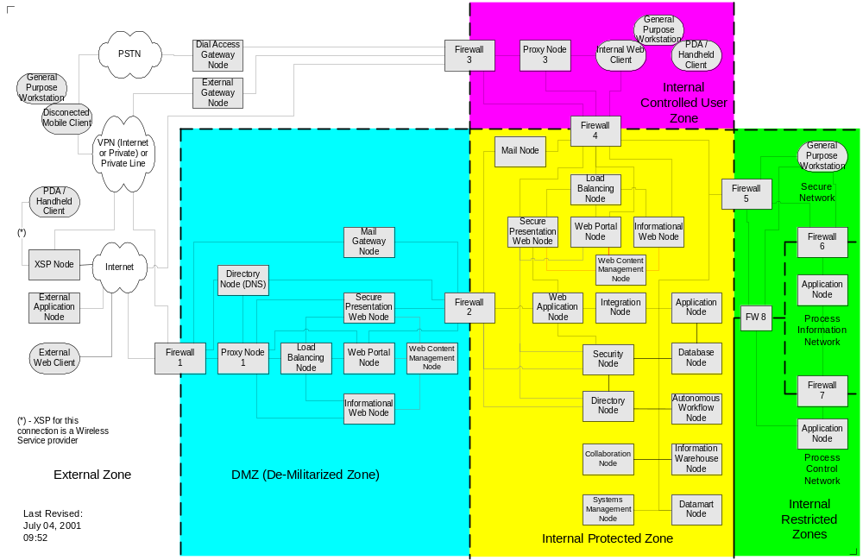
After Product Selection is made infrastructure assessment will be performed.
Example: Infrastructure Architecture
Example

Slide 10
EA backup

Slide 11
What is an Enterprise Architecture?
An Enterprise Architecture (EA) is a framework for both business and IT, which guides investment and design decisions and specifies processes, standards, interfaces and common services for the deployment and management of IT assets, in support of business objectives.
Business
Strategy
Enterprise Architecture
Business
Current
Drivers
Business
Environment
Business
Drivers
Business
Data
Application
IT
Strategy
IT Principles
Technology / Infrastructure
Current IT
Security
Environment
Models
Models
Models
Models
Processes
Processes
Processes
Processes
Plans
Plans
Plans
Plans
KGC Phase II EA Focus areas
Initiative
#1
Initiative
#2
Initiative
#3
Initiative
#n
An Enterprise Architecture is a bridge between the Business and IT Strategies and their implementation.

Slide 12
An Enterprise Architecture needs to consider three Architectural Dimensions
Business Segments
LoB-1
LoB-2
LoB-3
Business
Physical
Logical
Architecture
Domains
Application
Conceptual
Data
Architecture Models
Technology
A full Enterprise Architecture will complete all three Dimensions
However, any single Enterprise Architecture project will include only a subset of these Dimensions within its Scope and will assess the risks associated with that approach
The EA will evolve pragmatically over time as packages and components are selected, strategic projects are implemented and more detail is added.

Slide 13
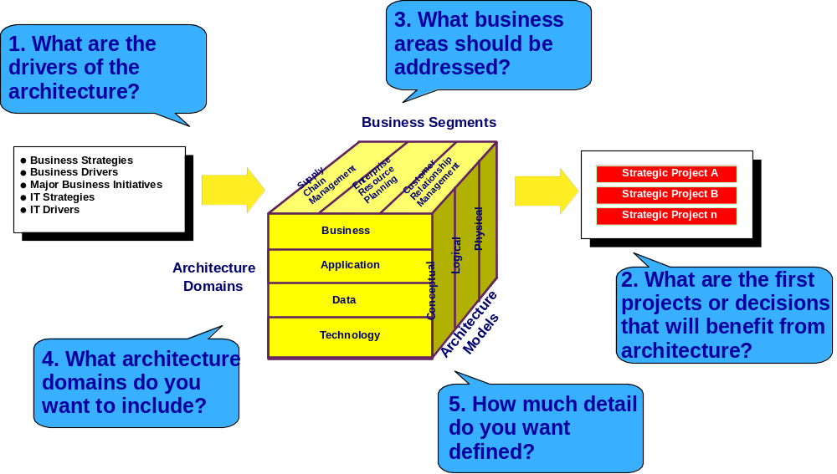
There are five major scoping questions associated with Enterprise Architecture ....

Slide 14
Example: Very High Level Architecture
POS
Sales
Inventory
Promotions
RMS
Inventory
Sales
Inventory
ERP
Example
Reports

